Slide 1

Binary Trees
"A tree may grow a thousand feet tall, but its leaves will return to its roots."
-Chinese Proverb

Slide 2
Your Observations (so far data structures)
Array
  Unordered
    Add, delete, search
  Ordered
Linked List
  ??
There are a number of applications where linear data structures are not appropriate.

Slide 3
Linked Lists Suck
When we are talking about searching or representing data structures that need a hierarchical structures.
We need a better structure…
So we get Binary Trees

Slide 4
Introduction to Tree
Combines advantages of an ordered array and a linked list.
  Searching as fast as in ordered array.
  Insertion and deletion as fast as in linked list.

Slide 5
Tree Data Structures
Consider a genealogy tree of a family.
Mohammad Aslam Khan
Sohail Aslam
Javed Aslam
Yasmeen Aslam
Haaris
Saad
Qasim
Asim
Fahd
Ahmad
Sara
Omer

Slide 6
Definition
A tree is an abstract data type
  Consists of nodes connected by edges.
    Nodes often represent entities (complex objects) such as people, car parts etc.
    Edges between the nodes represent the way the nodes are related.

Slide 7
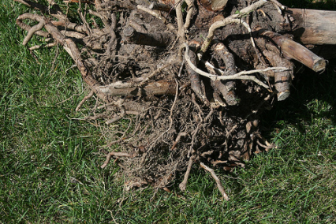

Properties of Trees
Only access point is the root
All nodes, except the root, have one parent
  like the inheritance hierarchy in Java
Traditionally trees drawn upside down
root
leaves

Slide 8
Properties of Trees
one entry point, the root
Each node is either a leaf or an internal node
An internal node has 1 or more children, nodes that can be reached directly from that internal node.
The internal node is said to be the parent of its child nodes
root node
internal
nodes
leaf nodes

Slide 9
Tree Visualization
A
B
C
D
E
F
G
H
I
J
K
L
M
N
O

Slide 10
Binary Trees
There are many variations on trees but we will start with binary trees
binary tree: each node has at most two children
  the possible children are usually referred to as the left child and the right child
parent
left child
right child

Slide 11
Binary Tree
A binary tree is a finite set of elements that is either empty or is partitioned into three disjoint subsets.
The first subset contains a single element called the root of the tree.
The other two subsets are themselves binary trees called the left and right subtrees.
Each element of a binary tree is called a node of the tree.

Slide 12
Binary Tree
Binary tree with 9 nodes.
A
B
C
D
E
F
G
H
I

Slide 13
Binary Tree
root
A
B
C
D
E
F
G
H
I
Left subtree
Right subtree

Slide 14
Binary Tree
Recursive definition
A
root
B
C
D
E
F
Left subtree
G
H
I
Right subtree

Slide 15
Binary Tree
Recursive definition
A
B
C
root
D
E
F
G
H
I
Left subtree

Slide 16
Binary Tree
Recursive definition
A
B
C
D
E
F
root
G
H
I

Slide 17
Binary Tree
Recursive definition
A
root
B
C
D
E
F
G
H
I
Right subtree

Slide 18
Binary Tree
Recursive definition
A
B
C
root
D
E
F
G
H
I
Left subtree
Right subtree

Slide 19
Not a Tree
Structures that are not trees.
A
B
C
D
E
F
G
H
I

Slide 20
Not a Tree
Structures that are not trees.
A
B
C
D
E
F
G
H
I

Slide 21
Not a Tree
Structures that are not trees.
A
B
C
D
E
F
G
H
I

Slide 22
Tree Terminology
Root: Node at the top of the tree.
Parent: Any node, except root has exactly one edge running upward to another node. The node above it is called parent.
Child: Any node may have one or more lines running downward to other nodes. Nodes below are children.
Siblings: Two nodes that have the same parent
Leaf: A node that has no children.
Subtree: Any node can be considered to be the root of a subtree, which consists of its children and its children’s children and so on.

Slide 23
Tree Terminology
Descendants: any nodes that can be reached via 1 or more edges from this node
Ancestors: any nodes for which this node is a descendant

Slide 24
Binary Tree: Terminology
parent
A
Left descendant
B
C
Right descendant
D
E
F
G
H
I
Leaf nodes
Leaf nodes

Slide 25
Tree Terminology
Keys: Key value is used to search for the item or perform other operations on it.
Edge/Branch: the link from one node to another
Visiting: A node is visited when program control arrives at the node, usually for processing.
Traversing: To traverse a tree means to visit all the nodes in some specified order.
Path: Traversal from node to node along the edges results in a sequence called path.

Slide 26
Tree Terminology
path length: the number of edges that must be traversed to get from one node to another
root
edge
siblings
path length from root to this
node is 3

Slide 27
Tree Terminology
Levels: The level of a particular node refers to how many generations the node is from the root. Root is assumed to be level 0.
The level of a node in a binary tree is defined as follows:
  Root has level 0,
  Level of any other node is one more than the level its parent (father).

Slide 28
Level of a Binary Tree Node
A
0
Level 0
B
1
C
1
Level 1
D
E
F
2
Level 2
2
2
G
H
3
I
3
Level 3
3

Slide 29
Tree Terminology
depth: the path length from the root of the tree to this node
  The depth of a binary tree is the maximum level of any leaf in the tree.
height of a node: The maximum distance (path length) of any leaf from this node
  a leaf has a height of 0
  the height of a tree is the height of the root of that tree

Slide 30
Special Trees
An empty tree has a height of zero.
A single node tree is a tree of height 1.
  This is the only case where a node is both a root and a leaf.

Slide 31
Full Binary Tree
full binary tree: a binary tree in which each node has exactly 2 or 0 children

Slide 32
Strictly Binary Tree
If every non-leaf node in a binary tree has non-empty left and right subtrees, the tree is termed a strictly binary tree.
A
B
C
D
E
J
F
G
K
H
I

Slide 33
Complete Binary Tree
A complete binary tree of depth d is the strictly binary all of whose leaves are at level d.
A
0
B
1
C
1
D
2
E
2
F
2
G
2
H
3
I
J
3
K
L
3
M
3
N
3
O
3

Slide 34
Complete Binary Tree
A
Level 0: 2⁰ nodes
B
C
Level 1: 2¹ nodes
D
E
F
G
Level 2: 2² nodes
H
I
J
K
L
M
N
O
Level 3: 2³ nodes

Slide 35
Complete Binary Tree
At level k, there are 2^{k} nodes.
Total number of nodes in the tree of depth d:
2⁰+ 2¹+ 2² + ………. + 2^{d} =  2^{j} = 2^{d+1} – 1
In a complete binary tree, there are 2^{d} leaf nodes and (2^{d} - 1) non-leaf (inner) nodes.
d
j=0

Slide 36
Complete Binary Tree
If the tree is built out of ‘n’ nodes then
n = 2^{d+1} – 1
or log₂(n+1) = d+1
or d = log₂(n+1) – 1
I.e., the depth of the complete binary tree built using ‘n’ nodes will be log₂(n+1) – 1.
For example, for n=100,000, log₂(100001) is less than 20; the tree would be 20 levels deep.
The significance of this shallowness will become evident later.

Slide 37
Operations on Binary Tree
There are a number of operations that can be defined for a binary tree.
If p is pointing to a node in an existing tree then
  left(p) returns pointer to the left subtree
  right(p) returns pointer to right subtree
  parent(p) returns the father of p
  brother(p) returns brother of p.
  info(p) returns content of the node.
Notes:
End of lecture 11

Slide 38
Traversing a Binary Tree
Suppose we have a binary tree, ordered or unordered.
We want to print all the values stored in the nodes of the tree.
In what order should we print them?

Slide 39
Traversing a Binary Tree
Ways to print a 3 node tree:
14
4
15
(4, 14, 15), (4,15,14)
(14,4,15), (14,15,4)
(15,4,14), (15,14,4)

Slide 40
Traversing a Binary Tree
In case of the general binary tree:
N
node
L
left subtree
right subtree
R
(L,N,R), (L,R,N)
(N,L,R), (N,R,L)
(R,L,N), (R,N,L)

Slide 41
Binary Tree Traversals
For a tree of n nodes there are n! traversals
Of course most of those are hard to program
There are two very common traversals
  Depth First
  Breadth First

Slide 42
Depth First
In a depth first traversal all the nodes on a branch are visited before any others are visited
There are three common depth first traversals
  Inorder
  Preorder
  Postorder
Each type has its use and specific application

Slide 43
Traversing a Binary Tree
Three common ways
N
node
left subtree
right subtree
L
R
Preorder: (N,L,R)
Inorder: (L,N,R)
Postorder: (L,R,N)

Slide 44
Traversing a Binary Tree
void preorder(TreeNode<int>* treeNode)
{
if( treeNode != NULL )
{
cout << *(treeNode->getInfo())<<" ";
preorder(treeNode->getLeft());
preorder(treeNode->getRight());
}
}

Slide 45
Traversing a Binary Tree
void inorder(TreeNode<int>* treeNode)
{
if( treeNode != NULL )
{
inorder(treeNode->getLeft());
cout << *(treeNode->getInfo())<<" ";
inorder(treeNode->getRight());
}
}

Slide 46
Traversing a Binary Tree
void postorder(TreeNode<int>* treeNode)
{
if( treeNode != NULL )
{
postorder(treeNode->getLeft());
postorder(treeNode->getRight());
cout << *(treeNode->getInfo())<<" ";
}
}

Slide 47
Traversing a Binary Tree
cout << "inorder: "; preorder( root);
cout << "inorder: "; inorder( root );
cout << "postorder: "; postorder( root );

Slide 48
Traversing a Binary Tree
14
4
15
3
9
18
7
16
20
5
17
Preorder: 14 4 3 9 7 5 15 18 16 17 20

Slide 49
Traversing a Binary Tree
14
4
15
3
9
18
7
16
20
5
17
Inorder: 3 4 5 7 9 14 15 16 17 18 20

Slide 50
Traversing a Binary Tree
14
4
15
3
9
18
7
16
20
5
17
Postorder: 3 5 7 9 4 17 16 20 18 15 14

Slide 51
Recursion: preorder
14
  preorder(14)
  14
  ..preorder(4)
  4
  ....preorder(3)
  3
  ......preorder(null)
  ......preorder(null)
  ....preorder(9)
  9
  ......preorder(7)
  7
  ........preorder(5)
  5
  ..........preorder(null)
  ..........preorder(null)
  ........preorder(null)
  ......preorder(null)
4
15
3
9
18
7
16
20
5
17

Slide 52
Recursion: preorder
14
  ..preorder(15)
  15
  ....preorder(null)
  ....preorder(18)
  18
  ......preorder(16)
  16
  ........preorder(null)
  ........preorder(17)
  17
  ..........preorder(null)
  ..........preorder(null)
  ......preorder(20)
  20
  ........preorder(null)
  ........preorder(null)
4
15
3
9
18
7
16
20
5
17

Slide 53
Recursion: inorder
14
  inorder(14)
  ..inorder(4)
  ....inorder(3)
  ......inorder(null)
  3
  ......inorder(null)
  4
  ....inorder(9)
  ......inorder(7)
  ........inorder(5)
  ..........inorder(null)
  5
  ..........inorder(null)
  7
  ........inorder(null)
  9
  ......inorder(null)
  14
4
15
3
9
18
7
16
20
5
17

Slide 54
Recursion: inorder
14
  ..inorder(15)
  ....inorder(null)
  15
  ....inorder(18)
  ......inorder(16)
  ........inorder(null)
  16
  ........inorder(17)
  ..........inorder(null)
  17
  ..........inorder(null)
  18
  ......inorder(20)
  ........inorder(null)
  20
  ........inorder(null)
4
15
3
9
18
7
16
20
5
17

Slide 55
Non Recursive Traversal
We can implement non-recursive versions of the preorder, inorder and postorder traversal by using an explicit stack.
The stack will be used to store the tree nodes in the appropriate order.
Here, for example, is the routine for inorder traversal that uses a stack.

Slide 56
Non Recursive Traversal
void inorder(TreeNode<int>* root)
{
Stack<TreeNode<int>* > stack;
TreeNode<int>* p;
p = root;
do
{
while( p != NULL )
{
stack.push( p );
p = p->getLeft();
}
// at this point, left tree is empty


Slide 57
Non Recursive Traversal
void inorder(TreeNode<int>* root)
{
Stack<TreeNode<int>* > stack;
TreeNode<int>* p;
p = root;
do
{
while( p != NULL )
{
stack.push( p );
p = p->getLeft();
}
// at this point, left tree is empty


Slide 58
Non Recursive Traversal
void inorder(TreeNode<int>* root)
{
Stack<TreeNode<int>* > stack;
TreeNode<int>* p;
p = root;
do
{
while( p != NULL )
{
stack.push( p );
p = p->getLeft();
}
// at this point, left tree is empty


Slide 59
Non Recursive Traversal

if( !stack.empty() )
{
p = stack.pop();
cout << *(p->getInfo()) << " ";
// go back & traverse right subtree
p = p->getRight();
}
} while ( !stack.empty() || p != NULL );
}

Slide 60
Non Recursive Traversal
if( !stack.empty() )
{
p = stack.pop();
cout << *(p->getInfo()) << " ";
// go back & traverse right subtree
p = p->getRight();
}
} while ( !stack.empty() || p != NULL );
}


Slide 61
Non Recursive Traversal
if( !stack.empty() )
{
p = stack.pop();
cout << *(p->getInfo()) << " ";
// go back & traverse right subtree
p = p->getRight();
}
} while ( !stack.empty() || p != NULL );
}


Slide 62
Non Recursive Traversal
if( !stack.empty() )
{
p = stack.pop();
cout << *(p->getInfo()) << " ";
// go back & traverse right subtree
p = p->getRight();
}
} while ( !stack.empty() || p != NULL );
}


Slide 63
Nonrecursive Inorder
14
push(14)
..push(4)
....push(3)
3
4
..push(9)
....push(7)
......push(5)
5
7
9
14
push(15)
15
push(18)
..push(16)
16
..push(17)
17
18
push(20)
20
4
15
3
9
18
7
16
20
5
17

Slide 64
Traversal Trace
recursive inorder
inorder(14)
..inorder(4)
....inorder(3)
3
4
..inorder(9)
....inorder(7)
......inorder(5)
5
7
9
14
inorder(15)
15
inorder(18)
..inorder(16)
16
..inorder(17)
17
18
inorder(20)
20
nonrecursive inorder
push(14)
..push(4)
....push(3)
3
4
..push(9)
....push(7)
......push(5)
5
7
9
14
push(15)
15
push(18)
..push(16)
16
..push(17)
17
18
push(20)
20


Slide 65
Traversal Trace
recursive inorder
inorder(14)
..inorder(4)
....inorder(3)
3
4
..inorder(9)
....inorder(7)
......inorder(5)
5
7
9
14
inorder(15)
15
inorder(18)
..inorder(16)
16
..inorder(17)
17
18
inorder(20)
20
nonrecursive inorder
push(14)
..push(4)
....push(3)
3
4
..push(9)
....push(7)
......push(5)
5
7
9
14
push(15)
15
push(18)
..push(16)
16
..push(17)
17
18
push(20)
20


Slide 66
Traversal Trace
recursive inorder
inorder(14)
..inorder(4)
....inorder(3)
3
4
..inorder(9)
....inorder(7)
......inorder(5)
5
7
9
14
inorder(15)
15
inorder(18)
..inorder(16)
16
..inorder(17)
17
18
inorder(20)
20
nonrecursive inorder
push(14)
..push(4)
....push(3)
3
4
..push(9)
....push(7)
......push(5)
5
7
9
14
push(15)
15
push(18)
..push(16)
16
..push(17)
17
18
push(20)
20


Slide 67
Traversal Trace
recursive inorder
inorder(14)
..inorder(4)
....inorder(3)
3
4
..inorder(9)
....inorder(7)
......inorder(5)
5
7
9
14
inorder(15)
15
inorder(18)
..inorder(16)
16
..inorder(17)
17
18
inorder(20)
20
nonrecursive inorder
push(14)
..push(4)
....push(3)
3
4
..push(9)
....push(7)
......push(5)
5
7
9
14
push(15)
15
push(18)
..push(16)
16
..push(17)
17
18
push(20)
20


Slide 68
Breadth First/Level-order Traversal
In a breadth first traversal all of the nodes on a given level are visited and then all of the nodes on the next level are visited.
Usually in a left to right fashion
This is implemented with a queue

Slide 69
Level-order Traversal
There is yet another way of traversing a binary tree that is not related to recursive traversal procedures discussed previously.
In level-order traversal, we visit the nodes at each level before proceeding to the next level.
At each level, we visit the nodes in a left-to-right order.

Slide 70
Level-order Traversal
14
4
15
3
9
18
7
16
20
5
17
Level-order: 14 4 15 3 9 18 7 16 20 5 17
Notes:
End of lecture 14

Slide 71
Binary Search Tree
A binary tree with the property that items in the left subtree are smaller than the root and items are larger or equal in the right subtree is called a binary search tree (BST).
The tree we built for searching for duplicate numbers was a binary search tree.
BST and its variations play an important role in searching algorithms.

Slide 72
Insertion in BST
14
14, 15, 4, 9, 7, 18, 3, 5, 16, 4, 20, 17, 9, 14, 5

Slide 73
Insertion in BST
15
14
15, 4, 9, 7, 18, 3, 5, 16, 4, 20, 17, 9, 14, 5

Slide 74
Insertion in BST
14
15
15, 4, 9, 7, 18, 3, 5, 16, 4, 20, 17, 9, 14, 5

Slide 75
Insertion in BST
4
14
15
4, 9, 7, 18, 3, 5, 16, 4, 20, 17, 9, 14, 5

Slide 76
Insertion in BST
14
4
15
4, 9, 7, 18, 3, 5, 16, 4, 20, 17, 9, 14, 5

Slide 77
Insertion in BST
9
14
4
15
9, 7, 18, 3, 5, 16, 4, 20, 17, 9, 14, 5

Slide 78
Insertion in BST
14
4
15
9
9, 7, 18, 3, 5, 16, 4, 20, 17, 9, 14, 5

Slide 79
Insertion in BST
7
14
4
15
9
7, 18, 3, 5, 16, 4, 20, 17, 9, 14, 5

Slide 80
Insertion in BST
14
4
15
9
7
7, 18, 3, 5, 16, 4, 20, 17, 9, 14, 5

Slide 81
Insertion in BST
18
14
4
15
9
7
18, 3, 5, 16, 4, 20, 17, 9, 14, 5

Slide 82
Insertion in BST
14
4
15
9
18
7
18, 3, 5, 16, 4, 20, 17, 9, 14, 5

Slide 83
Insertion in BST
3
14
4
15
9
18
7
3, 5, 16, 4, 20, 17, 9, 14, 5

Slide 84
Insertion in BST
14
4
15
3
9
18
7
3, 5, 16, 4, 20, 17, 9, 14, 5

Slide 85
Insertion in BST
5
14
4
15
3
9
18
7
5, 16, 4, 20, 17, 9, 14, 5

Slide 86
Insertion in BST
14
4
15
3
9
18
7
5
5, 16, 4, 20, 17, 9, 14, 5

Slide 87
Insertion in BST
16
14
4
15
3
9
18
7
5
16, 4, 20, 17, 9, 14, 5

Slide 88
Insertion in BST
14
4
15
3
9
18
7
16
5
16, 4, 20, 17, 9, 14, 5

Slide 89
Insertion in BST
4
14
4
15
3
9
18
7
16
5
4, 20, 17, 9, 14, 5

Slide 90
Insertion in BST
20
14
4
15
3
9
18
7
16
5
20, 17, 9, 14, 5

Slide 91
Insertion in BST
14
4
15
3
9
18
7
16
20
5
20, 17, 9, 14, 5

Slide 92
Insertion in BST
17
14
4
15
3
9
18
7
16
20
5
17, 9, 14, 5

Slide 93
Insertion in BST
14
4
15
3
9
18
7
16
20
5
17
17, 9, 14, 5

Slide 94
Insertion in BST
14
4
15
3
9
18
7
16
20
5
17
9, 14, 5

Slide 95
Trace of insert
p
17
q
14
4
15
3
9
18
7
16
20
5
17, 9, 14, 5

Slide 96
Trace of insert
p
17
14
4
q
15
3
9
18
7
16
20
5
17, 9, 14, 5

Slide 97
Trace of insert
17
14
4
p
15
q
3
9
18
7
16
20
5
17, 9, 14, 5

Slide 98
Trace of insert
17
14
4
p
15
3
9
q
18
7
16
20
5
17, 9, 14, 5

Slide 99
Trace of insert
17
14
4
15
3
9
p
18
q
7
16
20
5
17, 9, 14, 5

Slide 100
Trace of insert
17
14
4
15
3
9
p
18
7
q
16
20
5
17, 9, 14, 5

Slide 101
Trace of insert
17
14
4
15
3
9
18
p
7
q
16
20
5
17, 9, 14, 5

Slide 102
Trace of insert
17
14
4
15
3
9
18
p
7
16
20
q
5
17, 9, 14, 5

Slide 103
Trace of insert
14
4
15
3
9
18
7
p
16
20
5
node
17
17, 9, 14, 5
p->setRight( node );
Notes:
End of lecture 12

Slide 104
Deleting a node in BST
As is common with many data structures, the hardest operation is deletion.
Once we have found the node to be deleted, we need to consider several possibilities.

Slide 105
Deleting a Node
Start by finding the node you want to delete.
Then there are three cases to consider:
  The node to be deleted is a leaf
  The node to be deleted has one child
  The node to be deleted has two children

Slide 106
Deletion cases: Leaf Node
The appropriate node of the parent is set to null and the node is deallocated:
6
2
8
1
4
3

Slide 107
Deletion: One Child
The node to be deleted in this case has only two connections: to its parent and to its only child.
Connect the child of the node to the node’s parent, thus cutting off the connection between the node and its child, and between the node and its parent.
6
2
8
1
4
3

Slide 108
Deleting a node in BST
If the node has one child, the node can be deleted after its parent adjusts a pointer to bypass the node and connect to inorder successor.
6
2
8
1
4
3

Slide 109
Deleting a node in BST
The inorder traversal order has to be maintained after the delete.
6
↓
6
2
8
2
8
1
4
1
4
3
3

Slide 110
Deleting a node in BST
The inorder traversal order has to be maintained after the delete.
6
↓
6
↓
6
2
8
2
8
2
8
1
4
1
4
1
3
3
3

Slide 111
Deleting a node in BST
The complicated case is when the node to be deleted has both left and right subtrees.
The strategy is to replace the data of this node with the smallest data of the right subtree and recursively delete that node.

Slide 112
Deleting a node in BST
Delete(2): locate inorder successor
6
2
8
1
5
3
4
Inorder
successor
Notes:
Start lecture 16

Slide 113
Deleting a node in BST
Delete(2): locate inorder successor
6
Inorder successor will be the left-most node in the right subtree of 2.
The inorder successor will not have a left child because if it did, that child would be the left-most node.
2
8
1
5
3
4
Inorder
successor

Slide 114
Deleting a node in BST
Delete(2): copy data from inorder successor
6
↓
6
2
8
3
8
1
5
1
5
3
3
4
4

Slide 115
Deleting a node in BST
Delete(2): remove the inorder successor
6
↓
6
↓
6
2
8
3
8
3
8
1
5
1
5
1
5
3
3
3
4
4
4

Slide 116
Deleting a node in BST
Delete(2)
↓
6
↓
6
3
8
3
8
1
5
1
5
3
4
4
Notes:
End of lecture 15

Slide 117
Deletion: Two Children
To delete a node with two children, replace the node with its inorder successor.
For each node, the node with the next-highest key (to the deleted node) in the subtree is called its inorder successor.
To find the successor,
  start with the original (deleted) node’s right child.
  Then go to this node’s left child and then to its left child and so on, following down the path of left children.
  The last left child in this path is the successor of the original node.

Slide 118
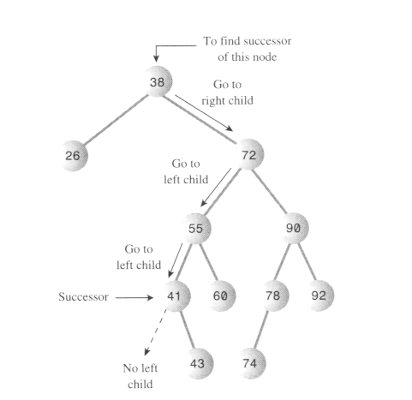
Find successor

Slide 119
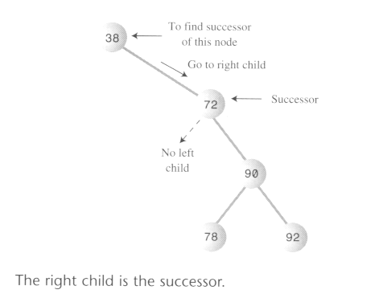
Find successor

Slide 120
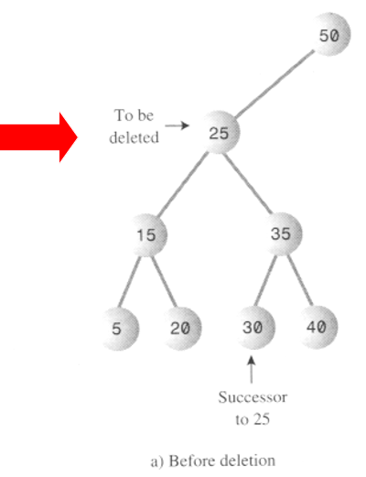
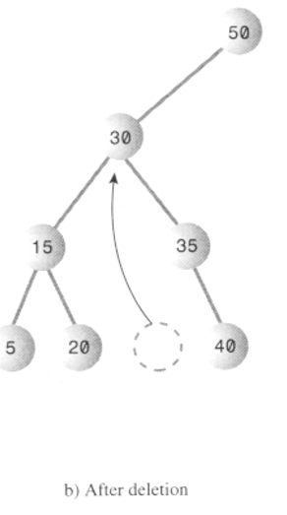
Delete a node with subtree (case 1)

Slide 121
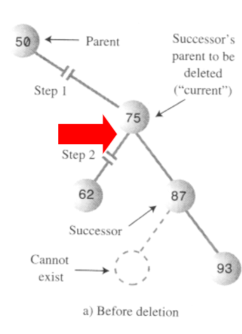
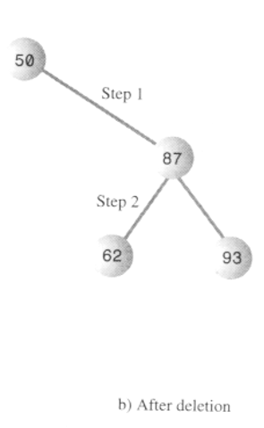
Delete a node with subtree (case 2)

Slide 122
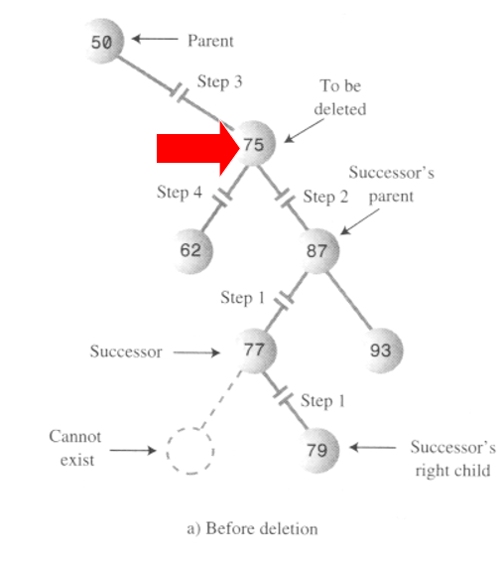
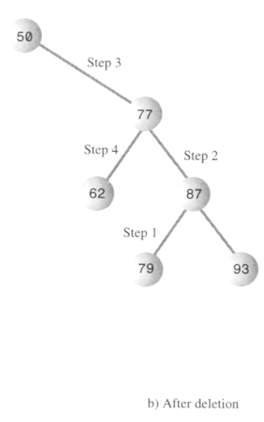
Delete a node with subtree (case 3)

